Slide 2
Critical Reading for Teachers of English
Agenda (22/11/2022) Dr. Cheewala Badklang
1. Welcome (English greetings), Introductions
2. Course Outline/Syllabus Search: focus, materials, expectations, grading
3. Basic Reading Strategies “powerpoint & handout” (reading aloud)
4. Intro Theme: News Article “Dangerous Crossing “ Homework
5. [Opt] What are your challenges for English reading skills? (writing/speaking)

Slide 3
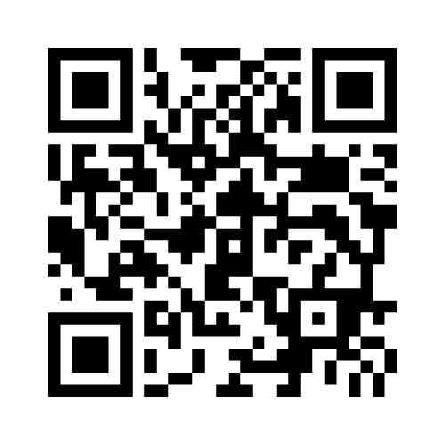
Critical Reading for Teachers of English
What are your challenges for English reading skills? (writing/speaking)
https://www.menti.com/alfpefo8ny4s

Slide 4
Critical Reading for Teachers of English
COURSE DESCRIPTION:
Study and practice a wide range of reading texts for comprehension, use reading strategies for enhancing reading ability, analyze text types and conduct reading activities
COURSE OBJECTIVES & ASSESSMENT: First Year English Education students will be able to
(1) Understand readings with comprehension questions & use given vocabulary words;
(2) Analyze reading types and strategies to prepare reading activities or short projects.

Slide 5
Critical Reading for Teachers of English
COURSE EXPECTATIONS & MATERIALS: First Year English Education students are expected to
(1) Attend and participate in the class
(2) Complete homework as assigned and meet deadlines.
Materials include: a notebook for writing vocabulary with definitions, and proverbs with meanings
Reading Theme: Global Health, Environmental issues, Education, Current events, etc.

Slide 6
Critical Reading for Teachers of English
GRADING:
Extensive reading 10%
Reading Exercises & Activities 40%
Test and/or Midterm 20%
Final Exam 30%
Total 100%

Slide 7
Extensive Reading
Select a storybook you would like to read for a pleasure (Level intermediate). For example,
Oxford Graded Readers
Pearson English Readers
Penguin Readers

Slide 8
Extensive Reading
2. Read the story you selected.
3. Summarize the story each time you read by jotting down on pages.
4. Conclude the story by combining every chapters.
5. Submit your story by writing and presenting
6. Time duration: 1 semester

Slide 9
Critical Reading for Teachers of English
https://forms.gle/61NMn4fcXSzRvbod7

Slide 10
Critical Reading for Teachers of English
Reading Skill & Strategy
https://www.youtube.com/watch?v=wTJYMfrjQg4

Slide 11
HOW TO IMPROVE COLLEGE READING SKILLS IN 10 STEPS
Preview the text to get an overall idea of what it's about. Read the chapter titles and section headings. Look over the photographs or illustrations and any side notes or special features in the margins. Scan the text for any bolded terms. If there are questions at the end of the chapter, preview those, too.
Focus your reading by deciding on a purpose. Of course you are reading because you are required to for the class, but choosing another purpose will help you stay on track as you read. For example, if the assigned reading is a chapter from your history textbook about the Cold War, one purpose for reading might be to discover the major players in the war, or the major causes of the war. Use the 5 "Ws" in setting your purpose: Who, what, when, where and why.

Slide 12
HOW TO IMPROVE COLLEGE READING SKILLS IN 10 STEPS
3. Keep track of what you read by taking notes. There are a variety of ways to take notes. Some people prefer to jot down important ideas in a notebook. Others might create an outline. If you learn best by seeing the text in graphic form, try creating a chart or diagram or even sketching pictures of what you read.
4. Mark the text in your book. If you own the book and are comfortable with writing in it, use a highlighter to capture key ideas. Write notes in the margins, including definitions for difficult words or points your instructor makes during lectures. If you don't own the book or prefer not to write in it, use sticky notes instead; stick them right in your book.

Slide 13
HOW TO IMPROVE COLLEGE READING SKILLS IN 10 STEPS
5. Be certain you've understood what you've read by stopping after each chunk of text and summarize the main ideas. If you're working in a study group, stop after each paragraph and have each person write a summary of the paragraph. Then compare summaries so no one misses any key points.
6. Paraphrase bits of text, especially those that are difficult to understand. When you paraphrase something, you essentially translate it into your own words.
7. Stop and look up a word only if knowing the word is essential to understanding the text. If the sentence still makes sense even if you do not know the word, skip it and keep on reading. If you're curious about the word, look it up later, but don't let it interfere with your reading. A good way to remember new words is to create flashcards and quiz yourself.

Slide 14
HOW TO IMPROVE COLLEGE READING SKILLS IN 10 STEPS
8. Ask questions about things you don't understand. One way to do this is to jot questions down on sticky notes and stick them in the margin of the text. Then look for the answers to the questions as you continue reading. If you can't find the answers, ask a classmate or your instructor.
9. Read critically, or question the text. Look for the main points the author of the text is trying to make. Ask yourself if the main ideas of the text are supported with evidence and if the evidence is logical and reliable. Look for any holes in the ideas presented, and don't be afraid to challenge ideas you don't agree with.
10. Reread the text. You don't have to reread the whole text, especially if it's very long, but you will benefit from rereading sections that are either very complicated or that you had a lot of questions about.

Slide 15
Critical Reading for Teachers of English
Reading Skill & Strategy
Read more: How to Improve College Reading Skills in 10 Steps | eHow.com
http://www.ehow.com/how_4472103_improve-college-reading-skills-10.html#ixzz124xPgxbA

Slide 16
Critical Reading for Teachers of English
News Article
Introduce vocabulary words & phrases.
News in Levels (2022, Nov 21). Dangerous Crossing. World News for Students of English. Retrieved from
https://www.newsinlevels.com/products/dangerous-crossing-level-3/

Slide 17
Exit Ticket
https://forms.gle/md9qFa1fXivd1GD29

