Slide 1
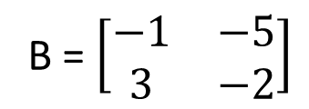
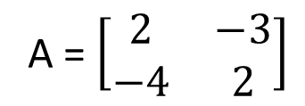
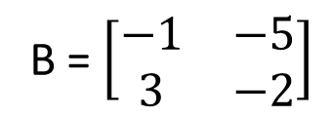
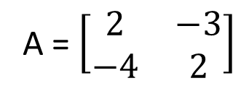
A + B = ?
A = $\left[\begin{matrix}2 & −3 \\ −4 & 2\end{matrix}\right]$
B = $\left[\begin{matrix}−1 & −5 \\ 3 & −2\end{matrix}\right]$
2. A - B = ?
A = $\left[\begin{matrix}2 & −3 \\ −4 & 2\end{matrix}\right]$
B = $\left[\begin{matrix}−1 & −5 \\ 3 & −2\end{matrix}\right]$

Slide 2
3. A + B = ?
A = $\left[\begin{matrix}3 & −5 & 4 \\ −1 & 4 & 6\end{matrix}\right]$
B = $\left[\begin{matrix}−1 & 4 & 2 \\ −5 & −2 & 3\end{matrix}\right]$
4. A - B = ?
A = $\left[\begin{matrix}3 & −5 & 4 \\ −1 & 4 & 6\end{matrix}\right]$
B = $\left[\begin{matrix}−1 & 4 & 2 \\ −5 & −2 & 3\end{matrix}\right]$

Slide 3
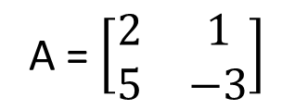
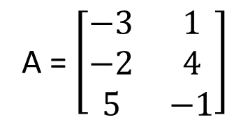
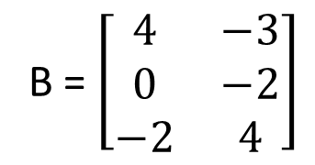
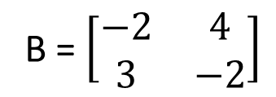
5. 3A - 2B = ?
A = $\left[\begin{matrix}−3 & 1 \\ −2 & 4 \\ 5 & −1\end{matrix}\right]$
B = $\left[\begin{matrix}4 & −3 \\ 0 & −2 \\ −2 & 4\end{matrix}\right]$
6. 2A - B^{T} = ?
A = $\left[\begin{matrix}2 & 1 \\ 5 & −3\end{matrix}\right]$
B = $\left[\begin{matrix}−2 & 4 \\ 3 & −2\end{matrix}\right]$
7. 2A + 5B = ?
A = $\left[\begin{matrix}1 & 2 & −3 \\ −5 & 4 & 2\end{matrix}\right]$
B = $\left[\begin{matrix}−2 & 6 & 4 \\ −1 & −2 & 3\end{matrix}\right]$

Slide 4
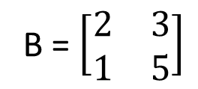
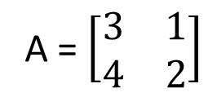
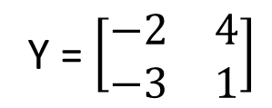
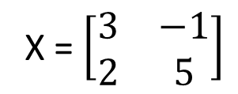
8. Which of the following products does not exist?
If a is a A(3 x 2) x B(2 x 3) matrix
b is a A(2 x 3) x B(2 x 3) matrix
c is a A(2 x 2) x B(2 x 3) matrix
d is a A(3 x 3) x B(3 x 2) matrix
9. AB = ?
A = $\left[\begin{matrix}3 & 1 \\ 4 & 2\end{matrix}\right]$
B = $\left[\begin{matrix}2 & 3 \\ 1 & 5\end{matrix}\right]$
10. XY = ?
X = $\left[\begin{matrix}3 & −1 \\ 2 & 5\end{matrix}\right]$
Y = $\left[\begin{matrix}−2 & 4 \\ −3 & 1\end{matrix}\right]$

Slide 5
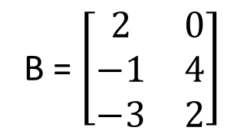
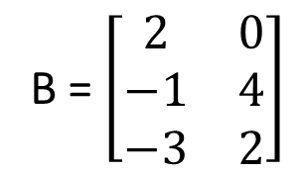
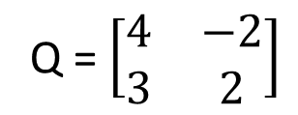
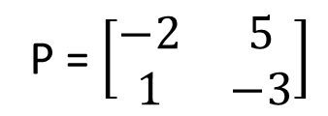
11. AB = ?
A = $\left[\begin{matrix}3 & −1 & 2 \\ −2 & 4 & 0\end{matrix}\right]$
B = $\left[\begin{matrix}2 & 0 \\ −1 & 4 \\ −3 & 2\end{matrix}\right]$
12. PQ = ?
P = $\left[\begin{matrix}−2 & 5 \\ 1 & −3\end{matrix}\right]$
Q = $\left[\begin{matrix}4 & −2 \\ 3 & 2\end{matrix}\right]$
13. BA = ?
A = $\left[\begin{matrix}3 & −1 & 2 \\ −2 & 4 & 0\end{matrix}\right]$
B = $\left[\begin{matrix}2 & 0 \\ −1 & 4 \\ −3 & 2\end{matrix}\right]$

Slide 6
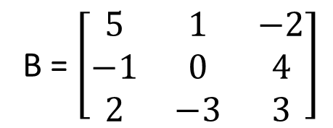
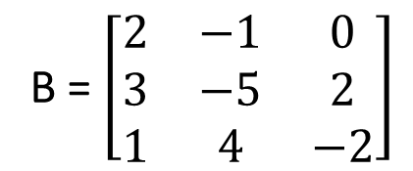
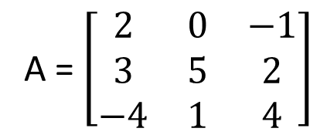
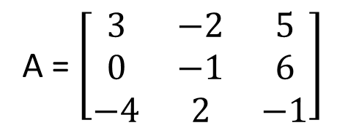
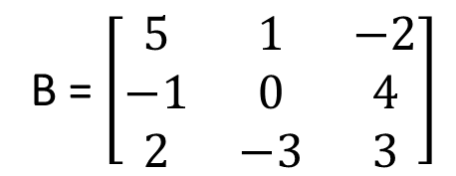
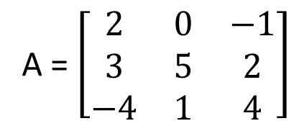
14. AB = ?
A = $\left[\begin{matrix}2 & 0 & −1 \\ 3 & 5 & 2 \\ −4 & 1 & 4\end{matrix}\right]$
B = $\left[\begin{matrix}5 & 1 & −2 \\ −1 & 0 & 4 \\ 2 & −3 & 3\end{matrix}\right]$
15. BA = ?
A = $\left[\begin{matrix}2 & 0 & −1 \\ 3 & 5 & 2 \\ −4 & 1 & 4\end{matrix}\right]$
B = $\left[\begin{matrix}5 & 1 & −2 \\ −1 & 0 & 4 \\ 2 & −3 & 3\end{matrix}\right]$
16. AB = ?
A = $\left[\begin{matrix}3 & −2 & 5 \\ 0 & −1 & 6 \\ −4 & 2 & −1\end{matrix}\right]$
B = $\left[\begin{matrix}2 & −1 & 0 \\ 3 & −5 & 2 \\ 1 & 4 & −2\end{matrix}\right]$

