Slide 1
Thai Values & US Values
Devora Manier

Slide 2
Relationships to Others
Collectivism
Individualism and Privacy
Explanation: Thai people care more about the group than themselves.
Result: Thai people might seem self-sacrificing and really focused on the group.
Explanation: In America, people think it's important to be themselves and have personal space.
Result: Americans like being independent, but it might make them seem a bit self-centered.

Slide 3
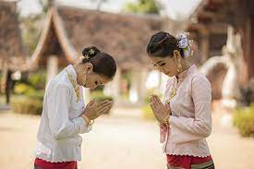
Level of Formality
Formality and Saving Face
Informality and Directness
Explanation: Thais respect older people and follow proper etiquette. They avoid causing problems or embarrassing others.
Result: Thais care a lot about how they appear to others and try to avoid confrontation.
Explanation: Americans don't like being too formal. They prefer being straightforward and telling the truth. They believe in honesty and not worrying about impressing others.
Result: Americans are casual and treat everyone equally. They value honesty over being overly formal.

Slide 4
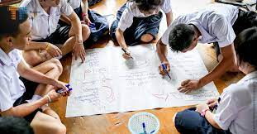
Work Relationships
Social Relationships
Competition & Work Orientation
Explanation: Thais value being good, generous, and having good connections, so they don't show strong negative emotions often.
Result: Thais prefer working cooperatively with people they know and trust. Social events are important.
Explanation: Americans believe competition is good and working hard is important. They think it's wrong to waste time.
Result: Americans focus on getting things done and competing with others. They think work is essential for success. Social events are just another time for business.

Slide 5
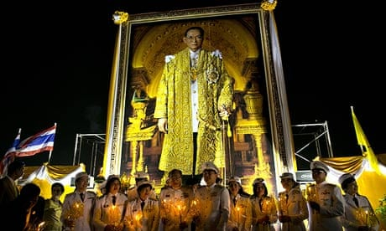
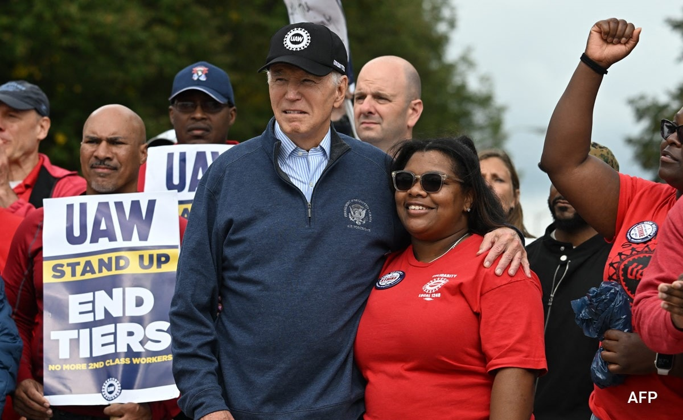
National Identity
The King & Unity
Equality and Diversity
Explanation: The king is very important in Thai culture, and disrespecting the king is not allowed. Thais are focused on supporting the national identity.
Result: It's against the law and socially wrong to disrespect the king or the royal family. He sets the tone for the national identity.
Explanation: In America, everyone is supposed to have the same chances. People are important for who they are, not where they come from.
Result: Americans treat everyone fairly & accept different traditions & perspectives. Even the president is subject to public criticism.

Slide 6
Family Relationships
Filial Piety
Time and Change
Explanation: Thais are grateful to their parents, guardians, and teachers.
Result: Family is important, and decisions are made considering the family's best interests.
Explanation: Time is valuable. Change is seen as good. Progress and improvement are important. Young people often reject the beliefs of their parents & grandparents.
Result: Americans like making progress, even if it means not spending as much time with family.

Slide 7
Showing & Earning Respect
Respect
Personal Responsibility
Explanation: Thais show respect by being honest, patient, and using polite language. They bring gifts when visiting someone's home and remove their shoes.
Result: Thais show respect by using proper titles and polite language. Disrespecting someone's home is not acceptable.
Explanation: Americans take pride in what they achieve on their own. They respect the achievements of others.
Result: Americans respect people for what they achieve, not just because of their family or their position.

