Slide 1
2108252
Week 3: Participles

Slide 2
Multiple-Meaning Words e.g. blind
My grandmother is almost totally blind.
Without treatment, the patient will go blind.
The operation left their son blind and brain-damaged.
The light was blinding, and she covered her face.
There's a blind man who sells popcorn on the corner.
But a blind person can still recognize a friend by the sound of his footsteps or even his scent.

Slide 3
Multiple-Meaning Words
None of the passengers was badly injured in the crash.
His fingers were badly frozen.
Businesses have been badly hit by the COVID-19 pandemic.
Both cars were badly damaged in the accident.
He needs the money really badly.
He played badly but I played even worse.
The refugees badly need food and clean water.
She wanted the job badly.

Slide 4
Translate these sentences into Thai.
More than six years have passed since a powerful earthquake and tsunami severely damaged the power plant.
Shooting has stopped since the announcement of a peace negotiation.

Slide 5
Conflicting opinions between two groups have kept
Japanese officials from doing anything about the water.
The U.S. Navy says it wants new ships that are slower and
smaller – but more powerful – than its existing ships.
Museum officials say visitors will be able to "experience the
magic of cinema" by learning about all parts of the film-
making process.

Slide 6
Underline every word showing a participle form in this following paragraph and then translate it.
The American holiday of Thanksgiving is celebrated every year on the fourth Thursday in November. The holiday is during autumn -- the main season for harvesting crops. Thanksgiving is an autumn harvest festival like those found in many cultures around the world.

Slide 7
Review: Participles as adjectives
The crying man is my neighbor.
I can’t catch a running train.
It was a fixed match.
When will you fix the broken window?
When I was 12, I suffered from a broken heart.
I bought myself a used car.
Don’t wake up the sleeping baby! The winning team will get 1 million dollars.

Slide 8
That boring online class put me to sleep!
She got a dancing doll for her birthday.
My soundly sleeping grandfather will soon get up for his dinner.
His essays are filled with well-rounded ideas.
Don’t be such a narrow-minded person.
He found some buried treasures in the castle.
How can we live in a society with a rapidly changing culture?
The leaping flames from the burning building presented the firefighters with the responsibility of protecting other nearby buildings from the growing fire.

Slide 9
Participial Phrases
A participle phrase also acts like an adjective to modify a noun, pronoun or noun phrase.
Present Participial Phrases
My mother is next to the lady wearing the red hat.
(The participle phrase "wearing the red hat" describes "the lady.")
แม่อยู่ถัดจากผู้หญิงคนที่ใส่หมวกแดง

Slide 10
I know a canal teeming with fish.
ฉันรู้ว่าที่คลองไหนมีปลาเยอะ
The man carrying the bricks is my father.
ผู้ชายคนที่แบกอิฐเป็นพ่อผมเอง
Have you ever seen anyone cutting their hair this way?
เคยเห็นใครตัดผมแบบนี้ไหม

Slide 11
That was her daughter dancing in her room.
We waved at the woman watering her plants.
The water dripping from the table will damage the floor if it is not cleaned up.
People living in Delhi are always complaining about the work the government does.

Slide 12
Review: Participial phrases created from adjective clauses
People who are living in glass houses should not throw stones. (clause)
People who live in glass houses should not throw stones. (clause)
People living in glass houses should not throw stones. (phrase)
Mary applied for a job that was advertised in the paper. (clause) Mary applied for a job advertised in the paper. (phrase)
Knoxville, which is located in Tennessee, is a medium-sized city. (clause)
Knoxville, located in Tennessee, is a medium-sized city. (phrase)

Slide 13
Participial Phrases vs. Gerund Phrases
Participial Phrase | Gerund Phrase
I watched the little girl playing with her jumping rope. (playing with her jump rope describes the girl.) | Playing with her jumping rope was the little girl's favorite thing to do. (Playing with her jump rope is a noun.)

Slide 14
Past Participial Phrases
I collected all the flowers cut by the gardener.
ฉันเอาดอกไม้ที่คนสวนตัดมาทั้งหมด
The little girl diagnosed with cancer has
written a book about her life.
Your friend killed in a car accident came in
my dream yesterday.

Slide 15
The insurance company will not pay for
everything destroyed by the fire.
Food sold in this supermarket is of the
highest quality.

Slide 16
Present and Past Participial Phrases
I heard the woman talking about the election.
The little girl diagnosed with cancer has written a book about her life.
The three of us got into the boat rented for a fishing trip.
My leg badly swollen from a bite by a snake is quite painful.

Slide 17
Participial phrases vs Reduced adjective clauses
If you receive an e-mail containing a virus, delete it immediately.
If you receive an e-mail which contains a virus, delete it immediately.
The man driving the car was not injured.
The man who drove the car was not injured.

Slide 18
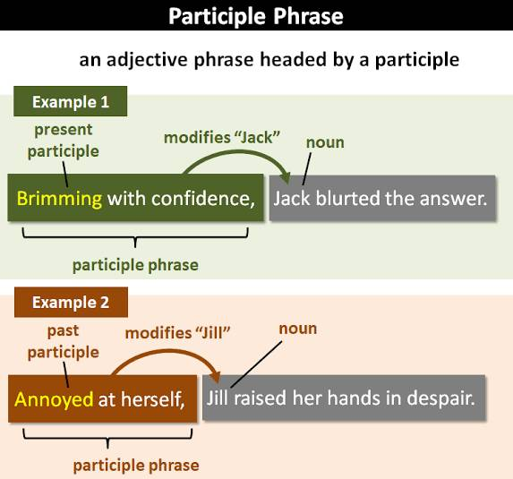

Slide 19
Participle clauses
Looked after carefully, these boots will last for many years.
Not wanting to hurt his feelings, I avoided the question.
Having lived through difficult times together, they were very close friends.

Slide 20
We can use participle clauses when the
participle and the verb in the main clause have the same subject.
Waiting for Ellie, I made some tea.
(While I was waiting for Ellie, I made some tea.)

Slide 21
Present participle clauses
To give the result of an action The bomb exploded, destroying the building.
To give the reason for an action Knowing she loved reading, Richard bought her a book.

Slide 22
Present participle clauses
To talk about an action that happened at the same time as another action Standing in the queue, I realized I didn't have any money.
To add information about the subject of the main clause Starting in the new year, the new policy bans
cars in the city center.

Slide 23
Past participle clauses
With a similar meaning to an if condition Used in this way, participles can make your writing more concise.
To give the reason for an action Worried by the news, she called the hospital.
To add information about the subject of the main clause Filled with pride, he walked towards the stage.

Slide 24
Perfect participle clauses
Perfect participle clauses show that the action they describe was finished before the action in the main clause.
Having got dressed, he slowly went downstairs. Having finished their training, they will be fully qualified doctors. Having been made redundant, she started looking for a new job.

Slide 27
Conclusion
A participle phrase often functions as an ADJECTIVE to modify a noun, pronoun or noun phrase.
A participle clause can be used when the participle and the verb in the main clause have the SAME subject.

Slide 28
How different is each sentence?
Shouting loudly, John walked home.
Shouted at loudly, John walked home.
Having been shouted at, John walked home.
After a long day at school and work, Jim found her roommate Ben eating the last of the leftover pizza.
Ben's rudest habit is eating the last of the leftover pizza.

Slide 29
Practice
Rising out of the sea in front of us, the sun started to warm our faces.
Having signed the document, Jason felt the weight of responsibility lift from his shoulders.
Removing his glasses, the professor shook his head with disappointment.
The boys loved their boxing gloves, wearing them even to bed.

Slide 30
Having gotten arrested, he shouted he was innocent.
Having finished their homework, they walked downstairs to go to the restaurant.
Three old men sitting on a bench in the park discussed the current situation.
Thanwa, excited by the news, rushed out of the room.
Not having slept for eighteen hours, he felt sick.
Not having any money, Susan decided to cut her hair herself.

