Slide 1
World Englishes and Varieties of English
Rebecca Oxford, Ph.D.
Professor and Distinguished Scholar-Teacher
and
Rashi Jain, Ph.D. Student
University of Maryland
For the National Museum of Language
October 12, 2008
Notes:
RO

Slide 2
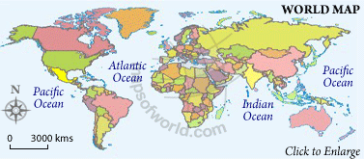
World Englishes
What is/are World English(es)?
“The expression ‘world Englishes’ is capable of a range of meanings and interpretations.” (p. 240, Bolton, 2006):
“…an umbrella label referring to a wide range of differing approaches to the description and analysis of English(es) worldwide.”
“…the ‘new Englishes’ found in the Caribbean and in West African and East African societies…and to…Asian Englishes…”
Notes:
RO

Slide 3
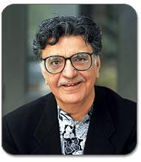
Kachru’s “Circles” Theory
Many varieties of English are found across the globe. Kachru (1992) has classified these varieties as those used in the ‘inner circle’, the ‘outer circle’, and the ‘expanding circle’.
Notes:
RO

Slide 4
Using Kachru’s circle theory
Studies suggest that there were (in 2001) an estimated
375 million users of English in Inner-Circle societies,
375 million in Outer-Circle (ESL) societies, and
750-1,000 million in the Expanding (EFL) Circle (McArthur, 2001)
The vast majority of teachers of English as a second and foreign language in the world today are ‘non-native’ teachers working in a wide range of settings in Outer-Circle and Expanding-Circle societies. (p. 261, Bolton, 2006).
Non-native English speaking teachers = NNESTs
Notes:
RO

Slide 5
A historical overview mentioning Kachru’s circles
The spread of Englishes
from the United Kingdom to countries where native English speakers have settled down in large numbers (Kachru’s Inner Circle countries, 1992): Australia, Canada, New Zealand, South Africa, and the United States as a first language for many
as a second language (Kachru’s Outer Circle, 1992): Examples - Hong Kong, India, Singapore
or a foreign language (Kachru’s Expanding Circle, 1992): Examples - Germany, Hungary, Poland, China, and Japan
Reasons for the spread (Kandiah, 1998):
colonization; ‘global village’
Notes:
RO

Slide 6
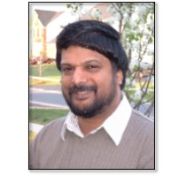
Canagarajah on Kachru’s model of the three circles
Canagarajah: “The Circles are leaking.”
Reasons:
Human migration, historical and current
Technology connects peoples (call center example)
Notes:
Rashi

Slide 7
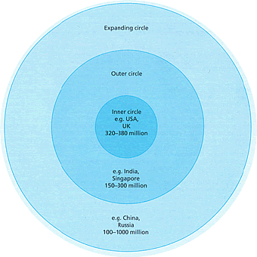
LOOKING AGAIN AT KACHRU’S CIRCLES . . . What do circles include, and what do they exclude? How would we change these circles?
(Notice numbers are different from McArthur’s estimates.)
Notes:
Rashi

Slide 8
Another way of classifying Englishes
New Englishes | Older Englishes | (English-based) Pidgins, Creoles and Decreolized varieties
Africa Kenyan English Nigerian English South Asia Indian English Lankan English Pakistani English Southeast Asia Filipino English Malaysian English Singpore English Etc. | North America American English Canadian English Great Britain English English Scots Northern Ireland and the Republic of Ireland Irish English Southern Indian and Pacific Oceans Australian English New Zealand English Etc. | Africa West African Pidgin Papua New Guinea Tok Pisin Sierra Leone Krio USA Black English Vernacular Hawaii English Creole Vanuatu Bislama Etc.
Source: p. 9, Kandiah, T. (1998) Why New Englishes?
Notes:
Rashi

Slide 9
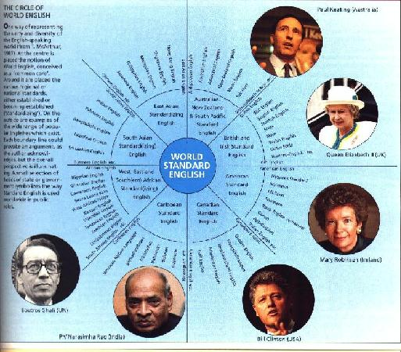
McArthur’s Concept:
World Standard English
Should and could there be a World Standard English? Whose? Why?
Notes:
Rashi

Slide 10
Canagarajah on McArthur’s model
“There is nothing in the center.”
Reasons:
There is NO universal English language, nor a World Standard English (WSE).
People construct English as suits their purposes in a given context at a given time.
Functionality and pragmatics are more relevant than WSE.
Notes:
Rashi

Slide 11
English as a double-edged sword
Even though the majority of ESL & EFL teachers in the world are NNESTs, some institutions fight to get NESTs (e.g., some Korea universities)
Ambivalence about non-native varieties in Outer Circle
Center still controls English language industry
textbooks
professional journals (changing somewhat)
the concept of who the “experts”
Notes:
RO with comments from Rashi

Slide 12
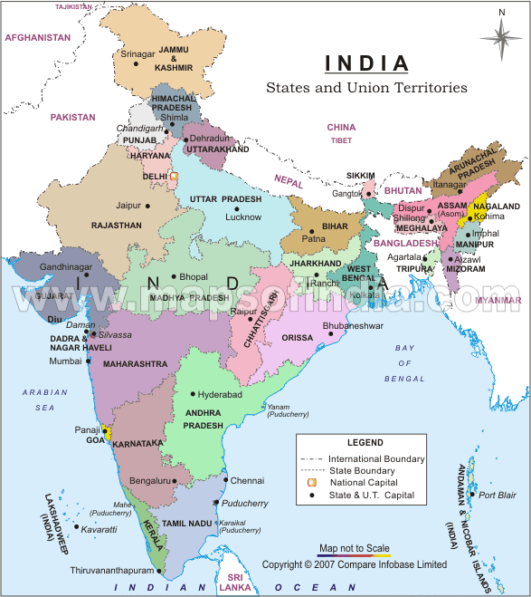
Legitimacy
However, in some some ESL contexts, such as India, locally produced materials in English may be given preference over Center-produced materials, and locally trained teachers are seen as legitimate English language teacher
India
Notes:
http://www.youtube.com/watch?v=r2SiEMj3SGc&feature=PlayList&p=4BFDB9A915296998&index=5

Slide 13
Varieties of English
The World of Englishes: The emergence and establishment of the many varieties of English, both international and intranational.
Reasons for the ‘varieties’: (p.3, Kandiah, 1998)
Development of language in ‘new and unfamiliar contexts’
Contexts marked by different ecological, cultural, linguistic, social, etc. characteristics.
Notes:
Rashi

Slide 14
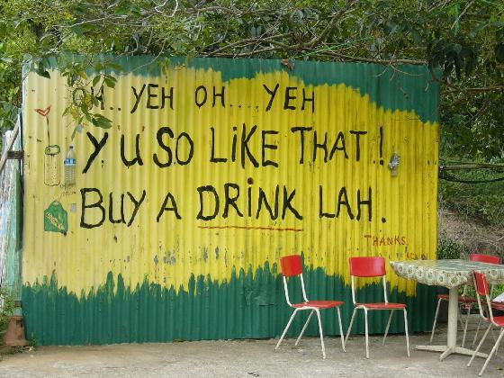
Notes:
RO

Slide 15
World Englishes
Notes:
RO

