Slide 1
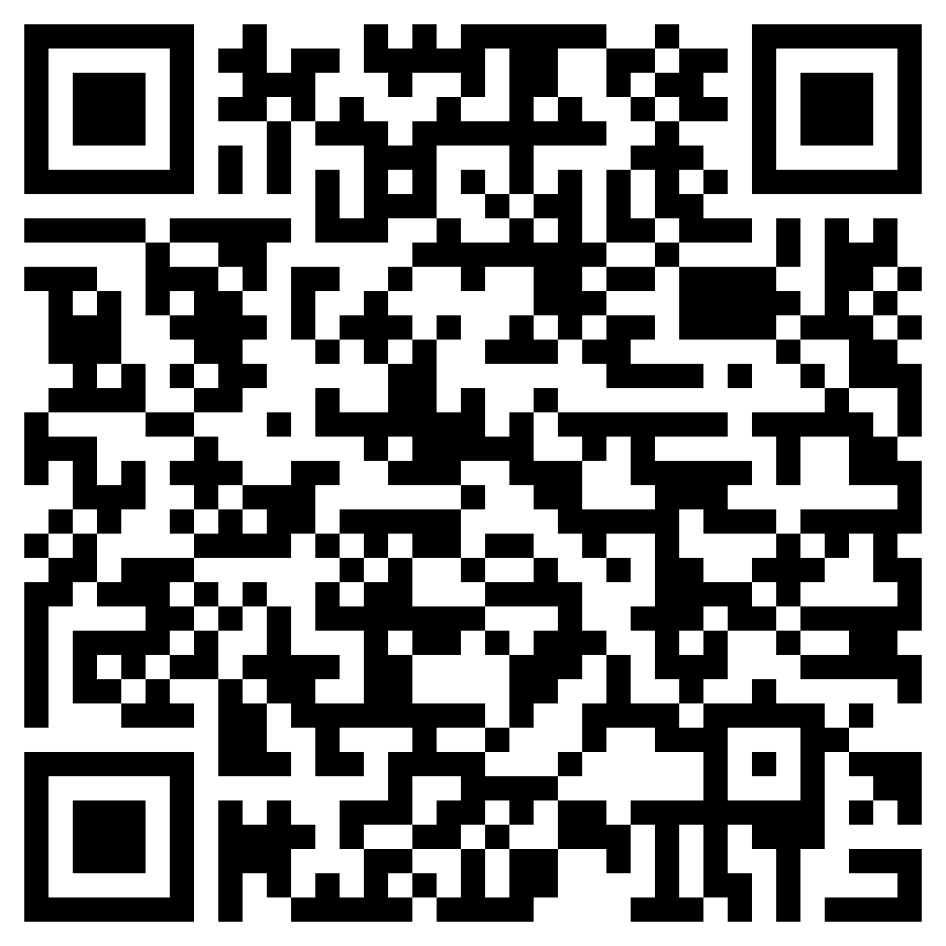
Question 1
What’s your name?

Slide 2
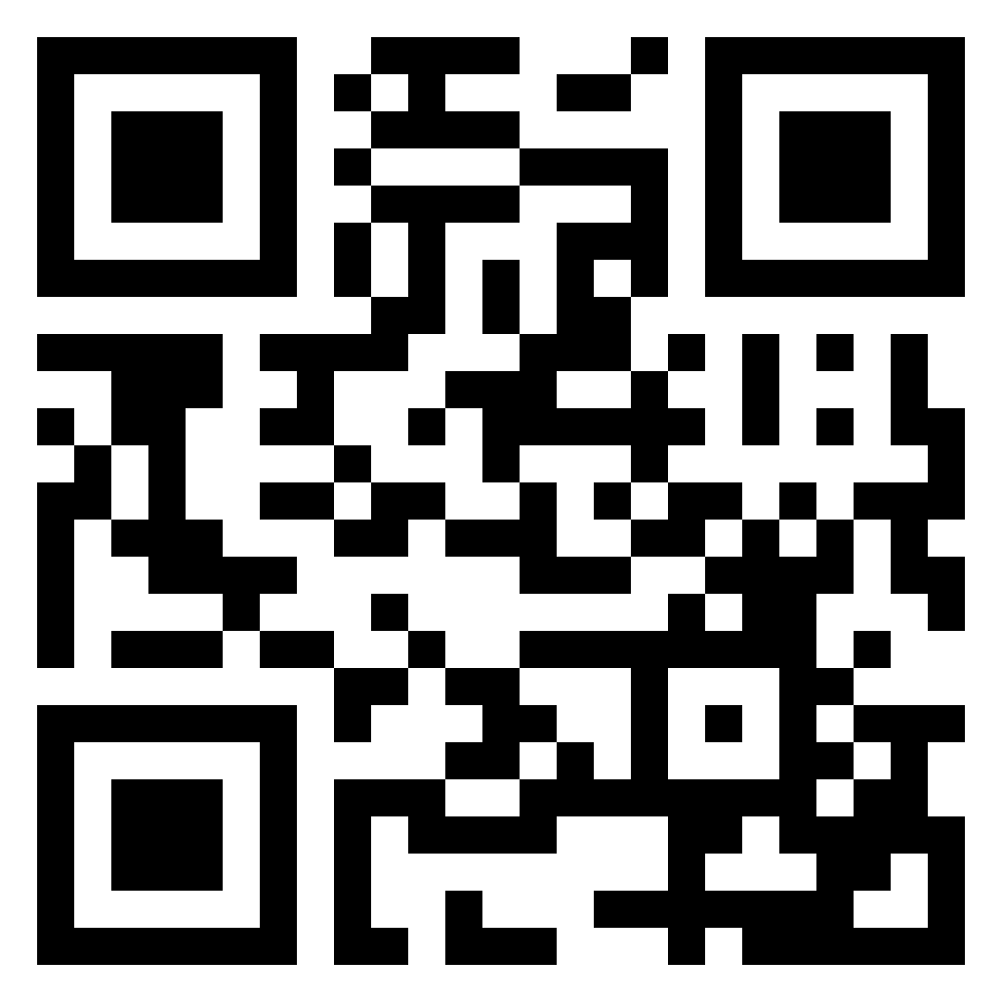
Question 2
Why English Program?

Slide 3
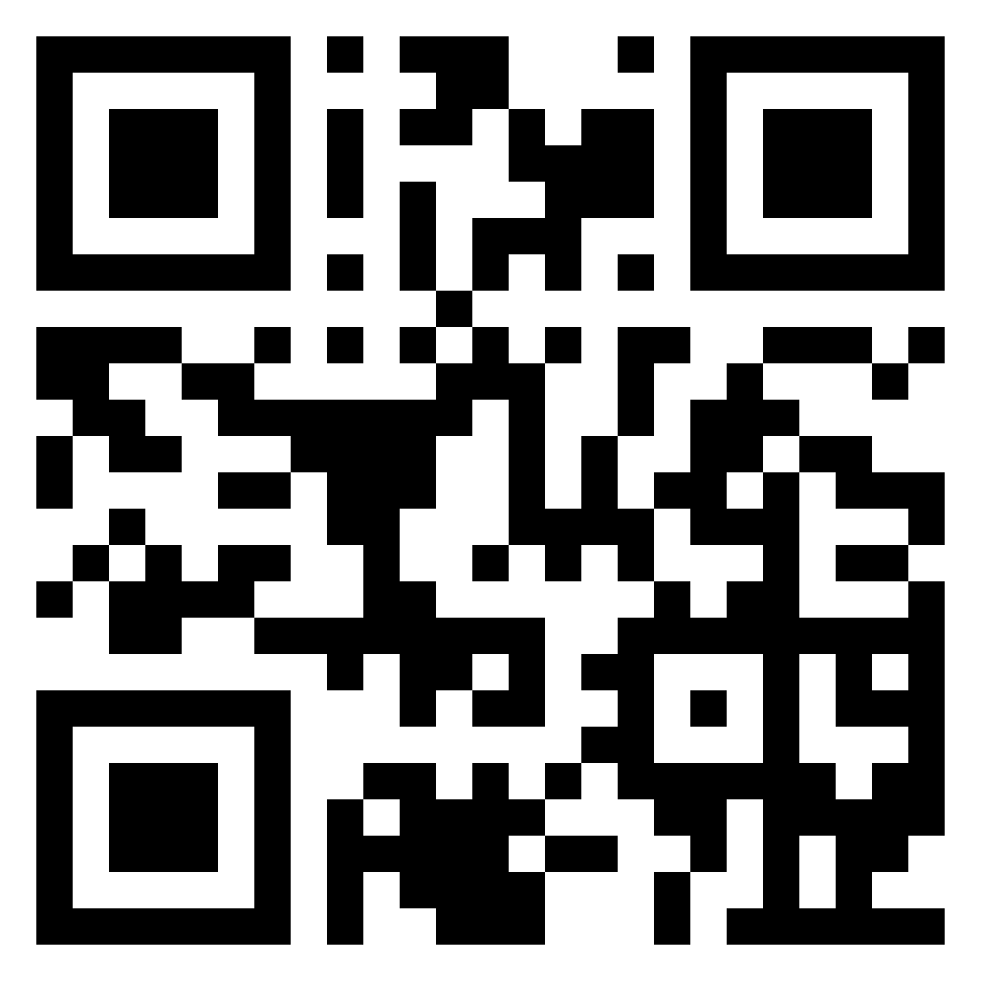
Question 3
What would you like to be in the future?

Slide 4
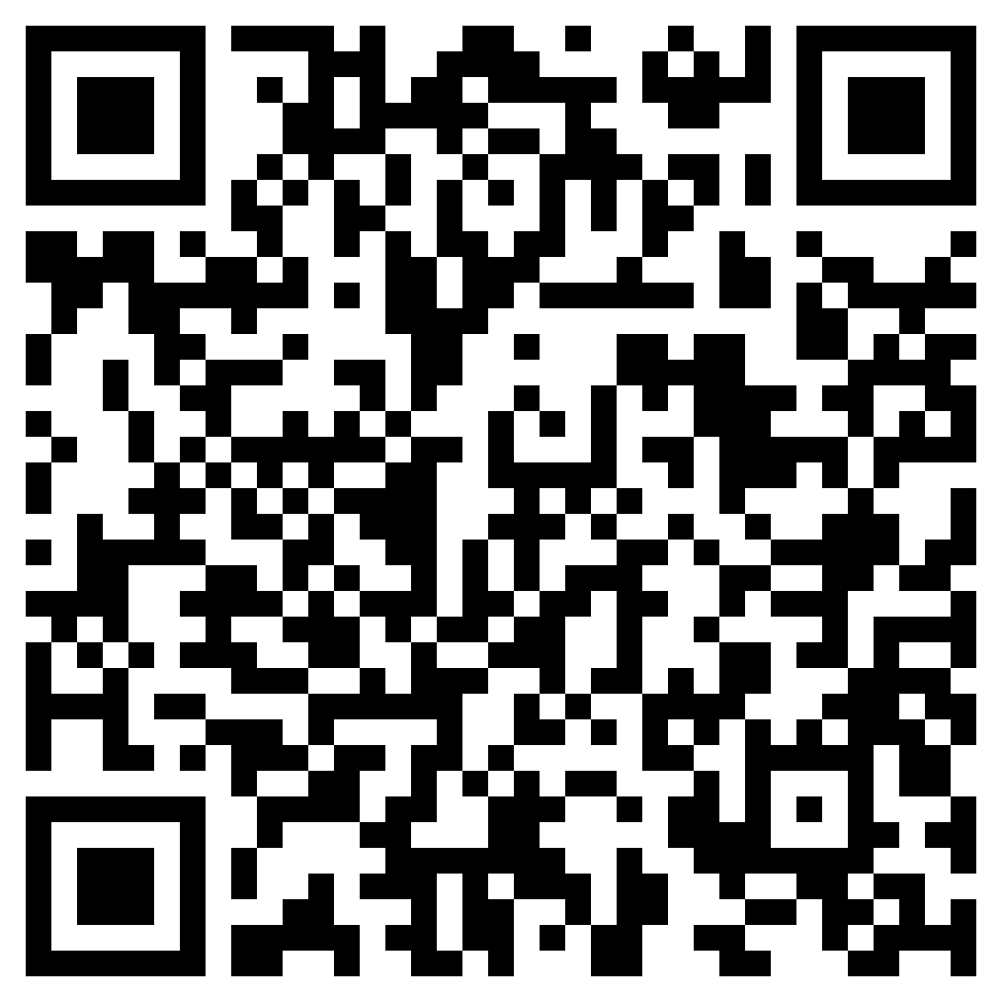
Question 3
Do you have any questions to ask me?

