Slide 1
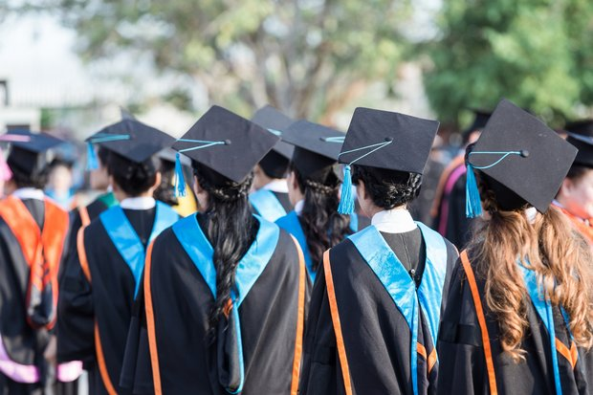
JOB and EDUCATION
Do you work or are you a student?

Slide 2
I am a student. I am studying…

Slide 3
I am studying…
I am studying.
You …. studying.
He …. studying.
She ... studying,
We …. studying.
You …. studying. (two or more persons)
They …. studying.

Slide 4
I am studying…
I am studying
You are studying.
He is studying.
She is studying.
We are studying.
You are studying.
They are studying.

Slide 5
-ING
VERB
VERB + ING
I work.
We study.
QUESTION:
Do you work?
Does he study?
ANSWER:
Yes, I work.
No, he does not study. No, he doesn‘t study.
I am working.
We are studying.
QUESTION:
Are you working?
… he studying?
ANSWER:
Yes, I am working. Yes, I‘m working.
No, he is not studying. No, he isn‘t studying.

Slide 6
JOB and EDUCATION
Do you work or are you a student?
I‘m a student and I am studying …. at ……University.
I am a student. My major is…
I work in a school, I‘m a teacher.
I‘m a university lecturer, I teach …. at …. University.
https://www.yru.ac.th/en/academics/view/faculties-and-organizations

Slide 7
WHICH LANGUAGES DO YOU SPEAK?

Slide 8
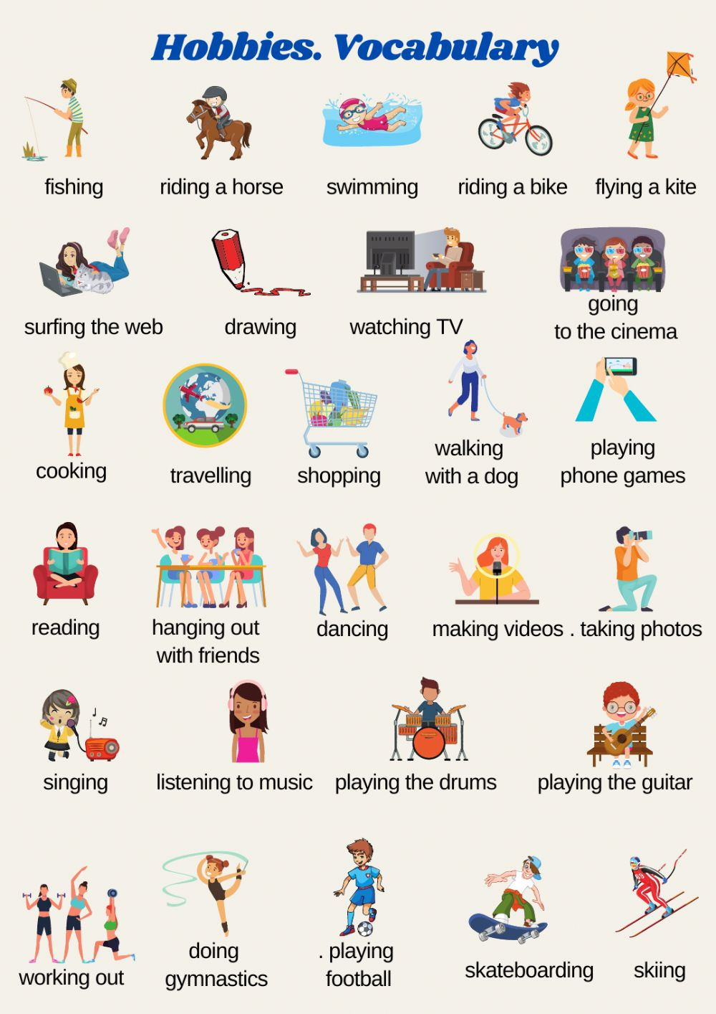
HOBBIES
What do you do in your free time?
What are your hobbies?

Slide 9
WHAT IS YOUR FAVORITE…
activity
food
drink
place (coffee shop, restaurant, park, …)
color
sport
subject (in school)
singer/band/music

